Slide 1
Store Sales Estimation
531 Advance Database Systems
Purva Chakravarti
Gurpreet Kaur
Ajinkya Bijwe
Professor: Kyoung-Seop Shin

Slide 2
Introduction
Problem statement: Sales estimation
Predict the quantity of sale of products for the year next year based on the historical data of past three years.
The sales are predicted on the basis of the sample dataset provided by the KDD website for the multi-departmental store.

Slide 3
Working
Our program calculates the rough estimate of sales in the particular store and the particular department based on data in .csv files.
Programing language: R programming
Output/Solution:
Predicted values shows that on the holidays
Super Bowl, Labor Day, Thanksgiving, and Christmas the sale is high.

Slide 4
Lets see what the .csv files do…
The .csv files are as following
Training.csv
Testing.csv
SampleStores.csv
StoreFeatures.csv
SampleOutput.csv

Slide 5
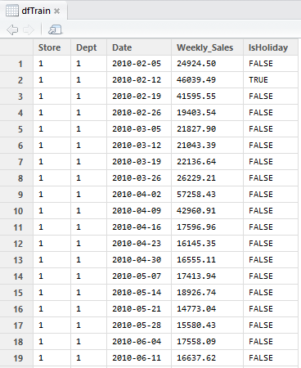
Learn about training.csv
12th feb 2012
HOLIDAY
SUPER BOWL
Value set to true.
Highest sale in store 1 department 1

Slide 6
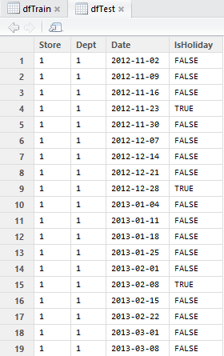
Learn about testing.csv

Slide 7
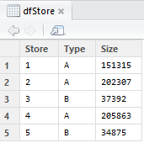
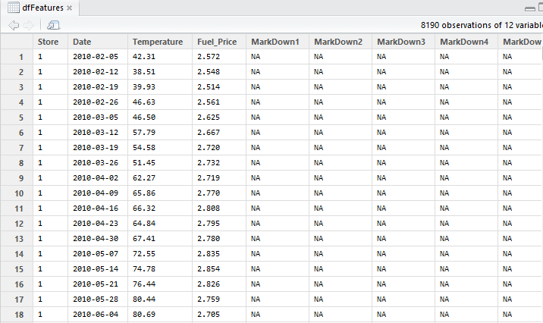
Learn about Samplestore.csv storefeatures.csv

Slide 8
Working continued…
Our logic is based on training and testing the model
The first part of the logic does the training of the dataset model
The packages imported into the logic are
1. TimeDate
Creates a ’timeDate’ object from scratch using a character vector.
Value returns an object of class timeDate.
2. Random Forest
Implements Breiman’s algorithm for classification and regression
Three concepts used:
Decision tree
Tree bagging
From Bagging to Random forest

Slide 9

PEEP TO THE DEMO of OUR

Slide 10
Demo
Logic is Divided into 4 steps
Importing the Data
Storing the data in Temporary Variables
Running the Logic (Random Forest)
Writing output .csv file

Slide 11
References
More about RandomForest : http://trevorstephens.com/post/73770963794/titanic-getting-started-with-r-part-5-random
https://www.stat.berkeley.edu/~breiman/RandomForests/cc_home.htm

Slide 12
Thankyou

